Slide 2
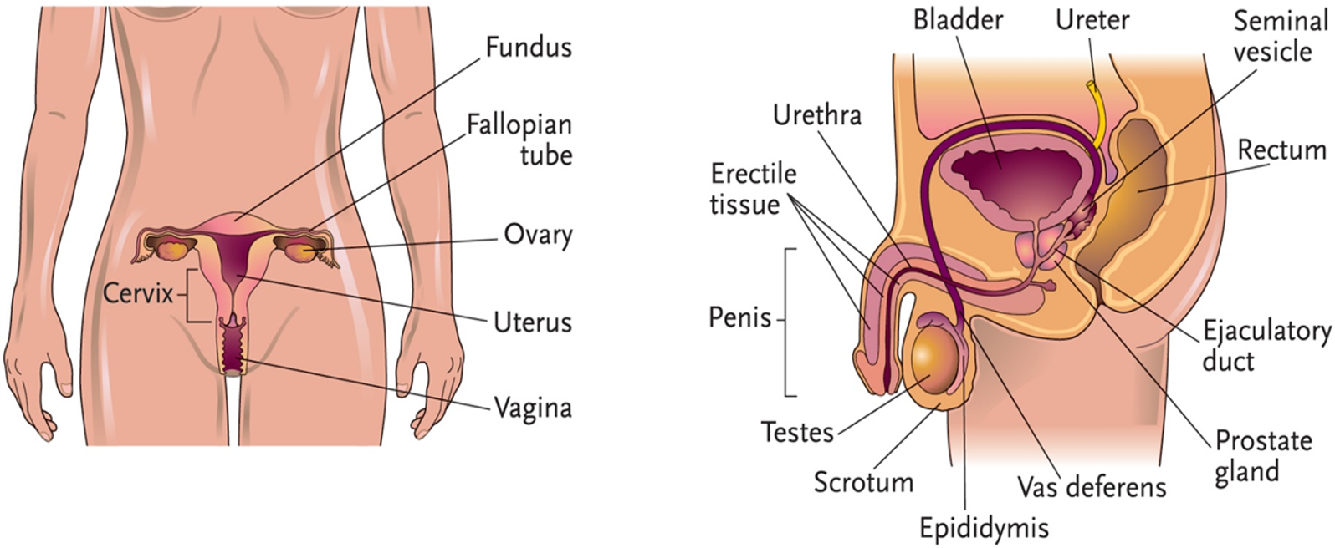
Chapter 18, LO1, content 1
Key Material 18-1 The Reproductive System (Male and Female)

Slide 3
LO1, content 2
Describe the reproductive system
Remember these points about the reproductive system:
Reproductive organs and hormones are different in males (testes, scrotum, testosterone) and females (ovaries, fallopian tubes, estrogen)
Reproductive system allows humans to reproduce

Slide 4
LO1, content 3
Describe the reproductive system
Normal changes of aging include the following:
Male:
Decreased sperm production
Enlarged prostate gland
Female:
Menstruation ends
Decreased estrogen leads to a loss of calcium, causing brittle bones and, potentially, osteoporosis
Drier, thinner vaginal walls

Slide 5
LO2, key terms
Discuss common medications used to treat conditions of the male reproductive system
Define the following terms:
benign prostatic hyperplasia (BPH)
a disor­der that can occur in men as they age, in which the prostate becomes enlarged and causes prob­lems with urination.
erectile dysfunction (ED)
a condition in which a male cannot get or keep an erection long enough to engage in sexual intercourse.

Slide 6
LO2, content 1
Discuss common medications used to treat conditions of the male reproductive system
Understand the following about treatment for benign prostatic hyperplasia (BPH):
Alpha-blockers relax smooth muscle of the prostate and bladder
Finasteride stops the creation of a substance related to the development of BPH
Tadalafil (Cialis) relaxes the smooth muscle cells of prostrate and bladder, allowing blood to flow more easily through the tissues
Table on textbook p. 171 (or handout) details other specific drugs

Slide 7
LO2, content 2
Discuss common medications used to treat conditions of the male reproductive system
Understand the following about treatment for erectile dysfunction (ED):
PDE5 inhibitors increase smooth muscle relaxation and improve blood flow
Must not be administered with nitrates (e.g., nitroglycerin)
Can cause headache, flushing, hypotension, dizziness, indigestion, back pain
Table on textbook p. 171 (or handout) details specific drugs

Slide 8
LO2, content 3
Discuss common medications used to treat conditions of the male reproductive system
Care guidelines for BPH and ED include the following:
Measure blood pressure as ordered
Drugs used to treat these conditions can cause low blood pressure and dizziness. Observe residents carefully to avoid falls. Report low blood pressure/complaints of dizziness to the nurse
Residents with BPH may need to have blood drawn regularly to measure levels of prostate specific antigen (PSA). Rising levels may be associated with prostate cancer
Administer tamsulosin (Flomax) about 30 minutes about resident has eaten a meal

Slide 9
LO3, key term
Discuss common medications used to treat conditions of the female reproductive system
Define the following term:
vaginitis
an inflammation of the vagina that may be caused by bacteria, protozoa, or a fungus.

Slide 10
LO3, content 1
Discuss common medications used to treat conditions of the female reproductive system
Understand the following about treatments related to post-menopausal conditions:
Hormone replacement can reduce osteoporosis risk
Local estrogen therapy may be ordered by vaginal administration
Table on textbook p. 171 (or handout) details specific drugs

Slide 11
LO3, content 2
Discuss common medications used to treat conditions of the female reproductive system
Understand the following about treatment for vaginitis:
Treatment depends on source of inflammation/infection
Oral/vaginal antibiotics for bacterial infections
Yeast (fungal) infection treatment includes oral or vaginal antifungal agents
Table on textbook p. 171–172 (or handout) details specific drugs

Slide 12
LO3, content 3
Discuss common medications used to treat conditions of the female reproductive system
Care guidelines for post-menopausal conditions and vaginitis include the following:
Hormone replacement therapy is associated with some dangerous side effects. It increases risk of blood clots. Observe residents for signs/symptoms of blood clots
Topical fungicides are available in different strengths and treatment lengths. Follow instructions on the MAR
Like antibiotics, fungicides should be taken for the full amount of time they are prescribed

Slide 13
LO4, key terms
Discuss common medications used to treat sexually transmitted infections
Define the following terms:
sexually transmitted infection (STI)
an in­fection caused by sexual contact with infected people; signs and symptoms are not always apparent.
genital herpes
an incurable type of sexually transmitted infection that is caused by a virus; causes painful sores on the genitals.
genital HPV infection
a type of sexually trans­mitted infection caused by human papillomavi­rus; may cause genital warts and an abnormal pap test, and can lead to cervical cancer.

Slide 14
LO4, content 1
Discuss common medications used to treat sexually transmitted infections
Understand the following about treatment for genital herpes:
Antiviral medications can prevent outbreaks, or can lesson duration/intensity
Side effects include nausea, vomiting, diarrhea, and headache
Table on textbook p. 172 (or handout) details specific drugs

Slide 15
LO4, content 2
Discuss common medications used to treat sexually transmitted infections
Understand the following about treatment for genital HPV infection:
Antiviral medications are not effective
Medication may be prescribed to treat the warts associated with HPV
Table on textbook p. 172 (or handout) details specific drugs

